Slide 1
SMART AGRICULTURE SYSTEM
Submitted By
Lucky Vishwkarma
HMRITM (GGSIPU)
INTERN AT SMARTBRIDGE

Slide 2
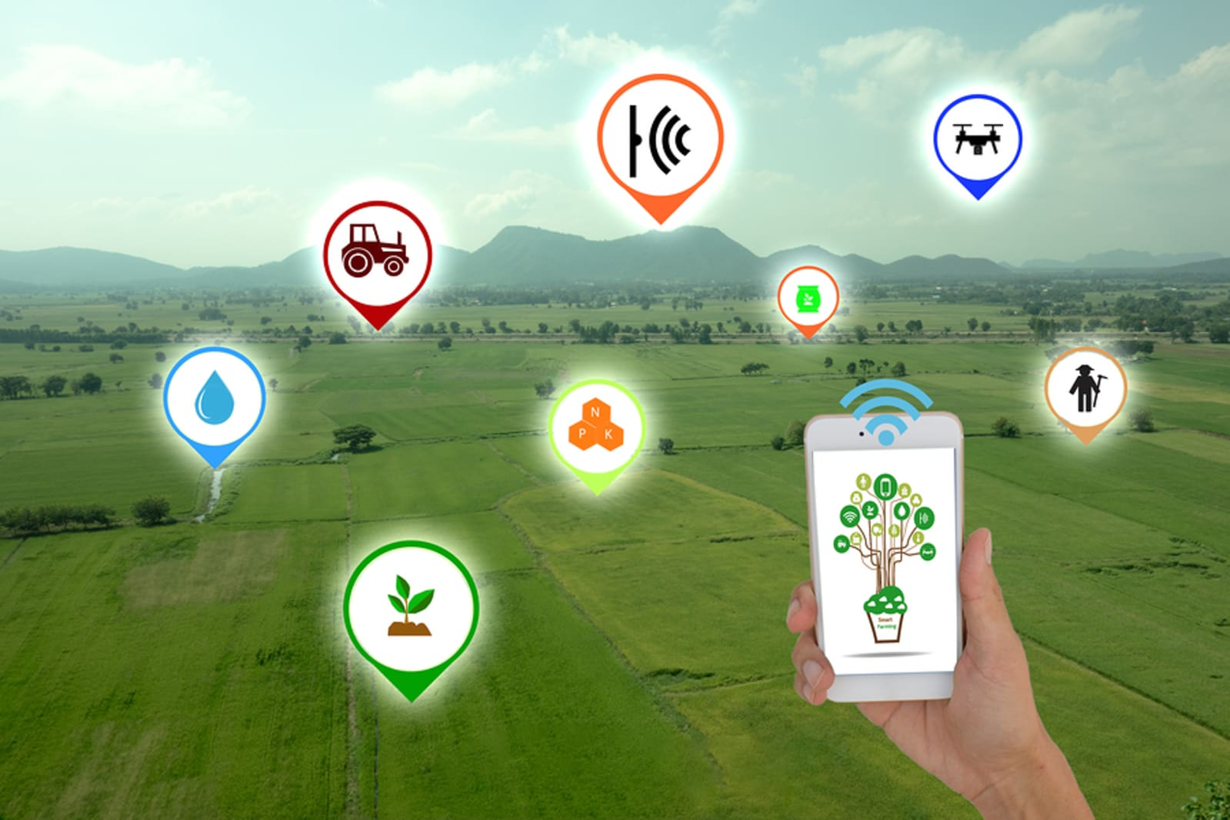
PURPOSE OF THE PROJECT
The Main Objective of the Project is to overcome the problems of the traditional agriculture system by developing a smart agriculture system that uses the advantages of the cutting edge technologies such as IoT , IBM Cloud & Open Weather API that will monitor the field in real time.
Smart Agriculture helps reduce overall costs and improve the quality and quantity of products, the sustainability of agriculture and the experience for the consumer. Increasing control over production leads to better cost management and waste reduction. Hope there will be many welcoming issues in the future regarding Smart agriculture.
With the help of this System, Farmer can get real time
weather forecasting and can monitor the weather
parameters using the mobile app. And also he can
water his crops by controlling the motor using the
mobile application from anywhere.

Slide 3
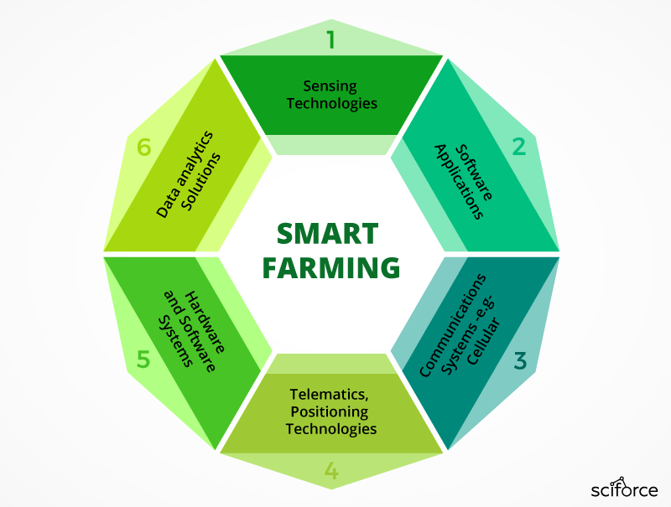
EXISTING PROBLEM a) Dependency upon rainfall to water the plants, so drought was a common issue. b) Absence of proper crop monitoring process doesn’t lead to enhancement in crop output efficiency. C) Insufficient agricultural methods due to absence of technological interface leads to large manpower & high cost.
PROPOSED SOLUTION
Smart Agriculture is a combination of modern information and communication technologies (ICT) with traditional farming practices to enhance the quality and quantity of agricultural products. Currently, a number of technologies are used to digitize the farming processes including sensors and actuators, robotics, GPS, big data, drone, etc. By adopting smart farming, farmers can reduce the additional costs, increase crop yield, improve the production of crops, and lessen labor.

Slide 4
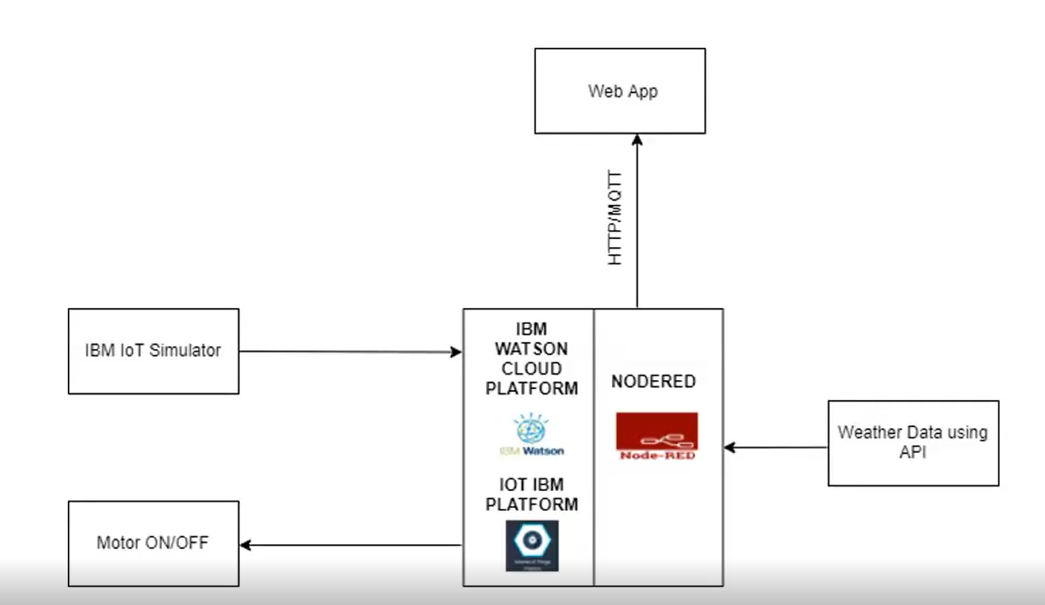
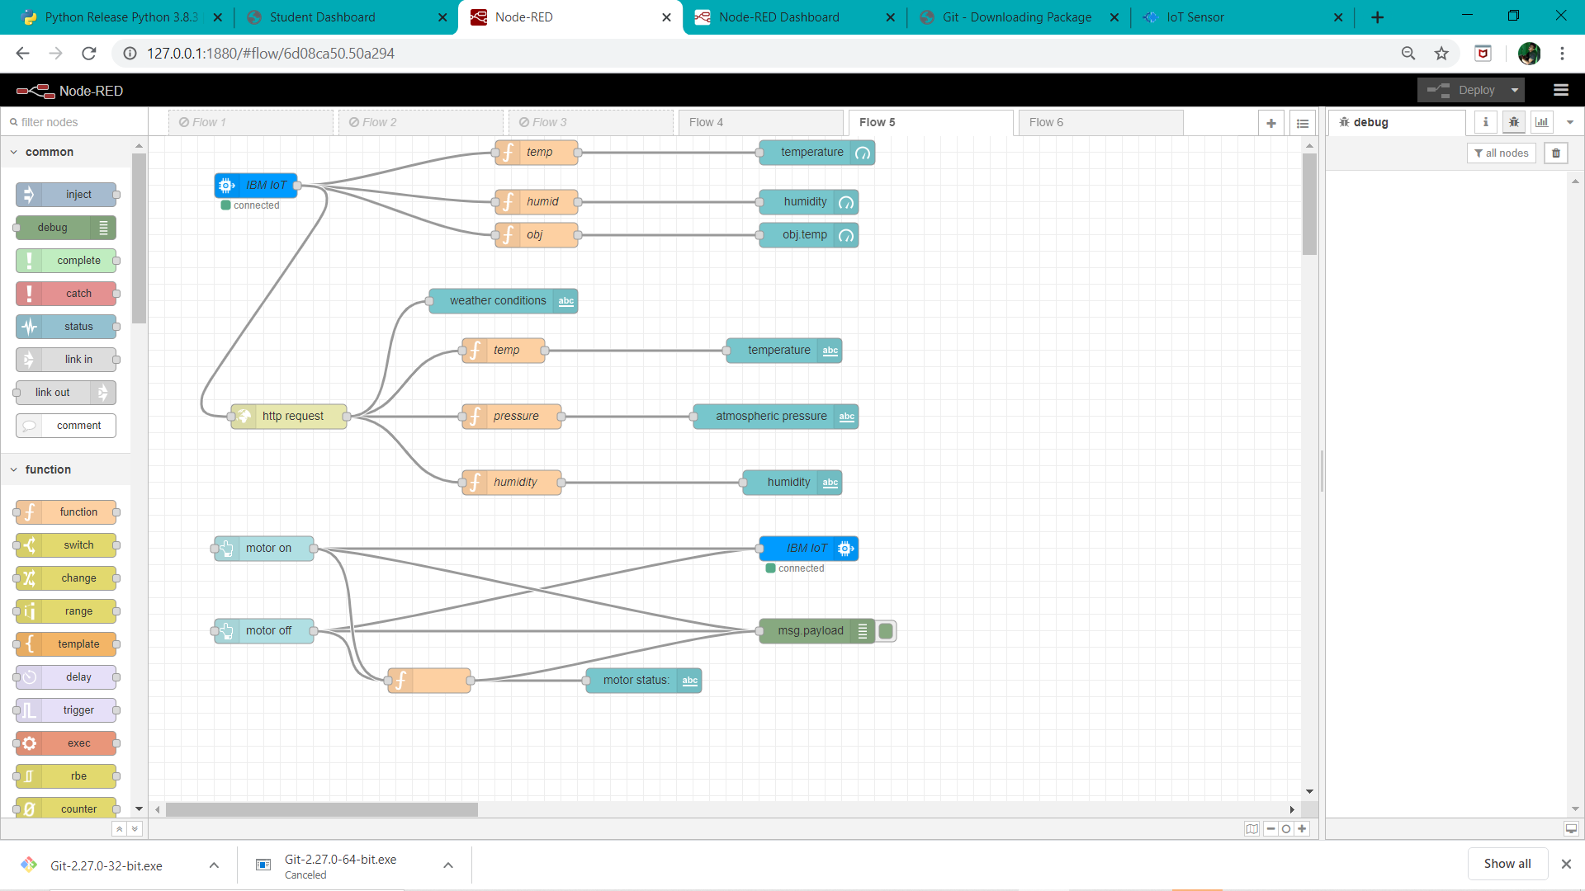
BLOCK DIAGRAM
NODE FLOW

Slide 5
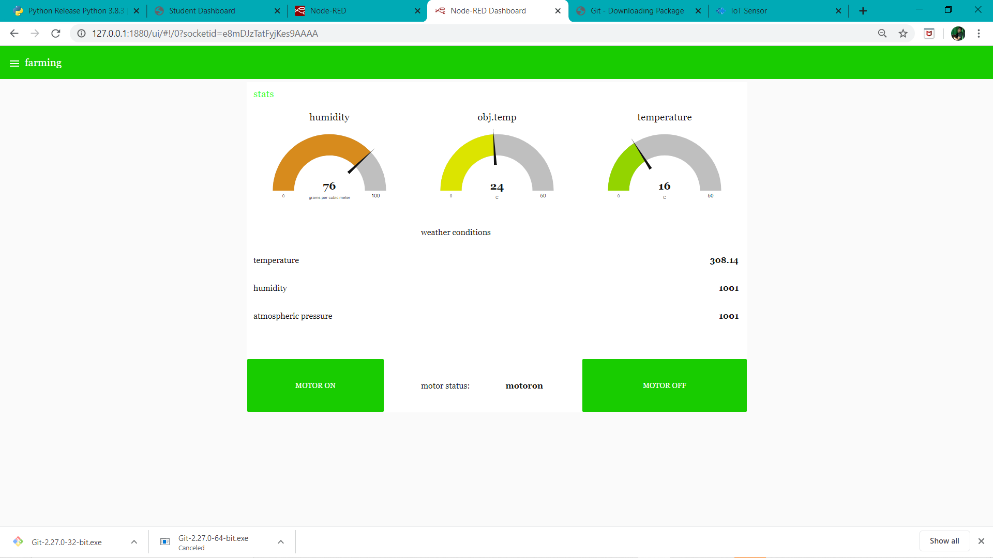
FUTURE SCOPE Smart Agriculture System is key for the future of agriculture Smart Farming is a farming management concept using modern technology to increase the quantity and quality of agricultural products. Farmers in the 21st century have access to GPS, soil scanning, data management, and Internet of Things technologies. By precisely measuring variations within a field and adapting the strategy accordingly, farmers can greatly increase the effectiveness of pesticides and fertilizers, and use them more selectively. Similarly, using Smart Farming techniques, farmers can better monitor the needs of individual animals and adjust their nutrition correspondingly, thereby preventing disease and enhancing herd health.
USER INTERFACE

